Slide 1

ADVANCED ANALYSIS ON STUDENT ACADEMIC PERFORMANCE AND DIGITAL DISTRACTIONS
3MTT CAPSTONE PROJECT
DASHBOARD ANALYSIS
Exploring how digital distractions , and study habits affect student productivity

Slide 2
KEY METRICS AT A GLANCE
Overview
20,000
50.18
70.27
4.30
Total Students
Avg Productivity
Avg Final Grade
Avg Study Hours
Full dataset
Out of 100
Out of 100
Hours/day
DISTRACTION BREAKDOWN
STUDY ENGAGEMENT
Highly Distracted
18,077
90.4%
Highly Engaged
2,017
10.1%
Moderately Distracted
1,898
9.5%
Engaged
11,877
59.4%
Focused
25
0.1%
Under-Engaged
6,106
30.5%
Student Productivity Dashboard | Executive Summary

Slide 3
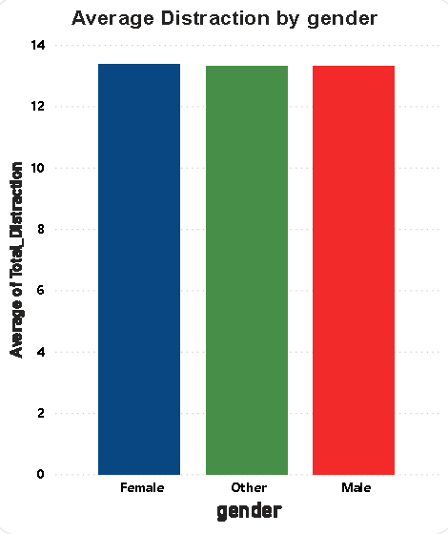
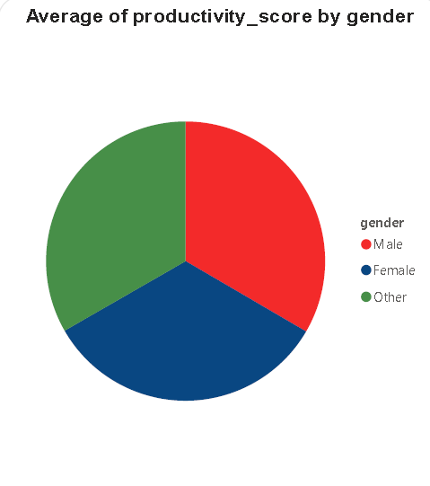
GENDER ANALYSIS
Gender
9,582
9,640
778
13.33
Male
Female
Other
Avg Distraction
Student Productivity Dashboard | Executive Summary

Slide 4
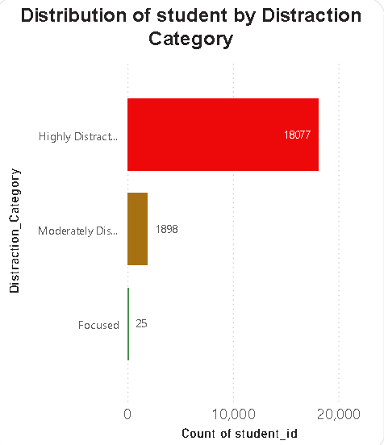
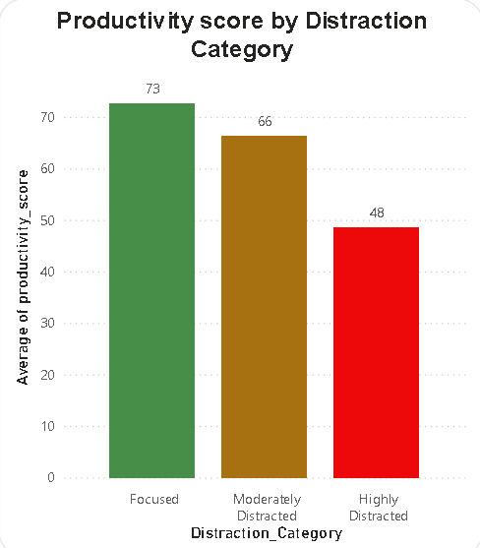
DISTRACTION ANALYSIS
Distraction
⚠ KEY INSIGHT: 90.4% of students (18,077) are Highly Distracted, with an average productivity score of only 48 vs. 73 for Focused students. Phone usage and social media are the primary distraction drivers — a 34% productivity gap demands urgent intervention.
Student Productivity Dashboard | Executive Summary

Slide 5
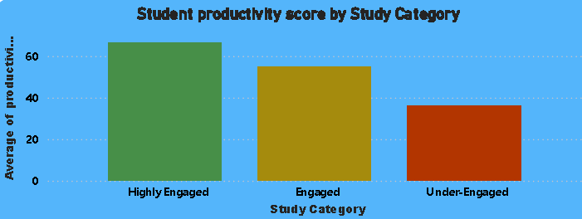
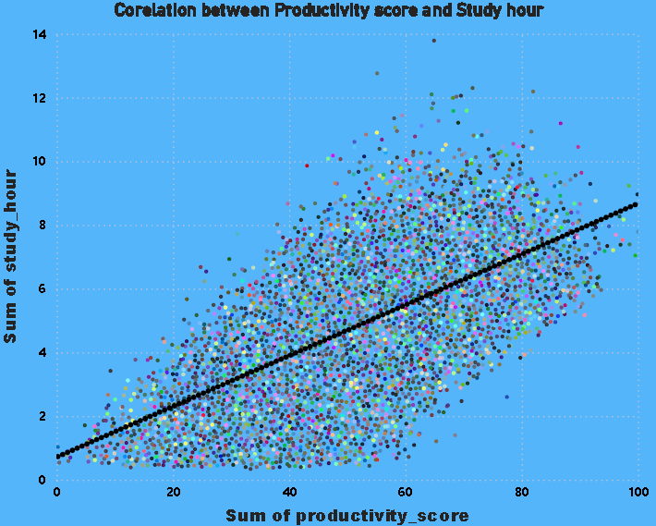
STUDY ENGAGEMENT ANALYSIS
Study Category
2,017
11,877
6,106
Highly Engaged
Engaged
Under-Engaged
10.1% of students
59.4% of students
30.5% of students
Student Productivity Dashboard | Executive Summary

Slide 6
KEY FINDINGS & RECOMMENDATIONS
📊 KEY FINDINGS
✅ RECOMMENDATIONS
⚠ 90.4% of students are Highly Distracted — only 25 students (0.1%) are Focused
📵 Implement phone-free study zones and digital detox programs
📉 Highly Distracted students score 34% lower in productivity (48 vs. 73)
🏆 Reward and showcase Focused students to inspire peers
👥 Gender breakdown is near-equal: Male 47.9%, Female 48.2%, Other 3.9%
📅 Introduce structured study hour programs targeting Under-Engaged students
📚 Only 10.1% of students are Highly Engaged in their studies
🔔 Deploy real-time distraction monitoring and nudge notifications
📈 Strong positive correlation between study hours and productivity score
🎓 Provide targeted support for the 6,106 Under-Engaged students
📈 Negative correlation between total distraction and productivity score
Student Productivity Dashboard | 3MTT Capstone Project 2026

